Slide 1
FIRST STEPS TOWARDS SUSTAINABLE
MOBILITY IN TOURISM – THE SEEMORE PROJECT
IEE-011­0951/ From April 2012 to April 2015

Slide 2
Project Summary
SEEMORE introduces energy efficient transport solutions for visitors in eight coastal regions with the goal to reduce the number of car trips made by tourists during their holidays.
2

Slide 3
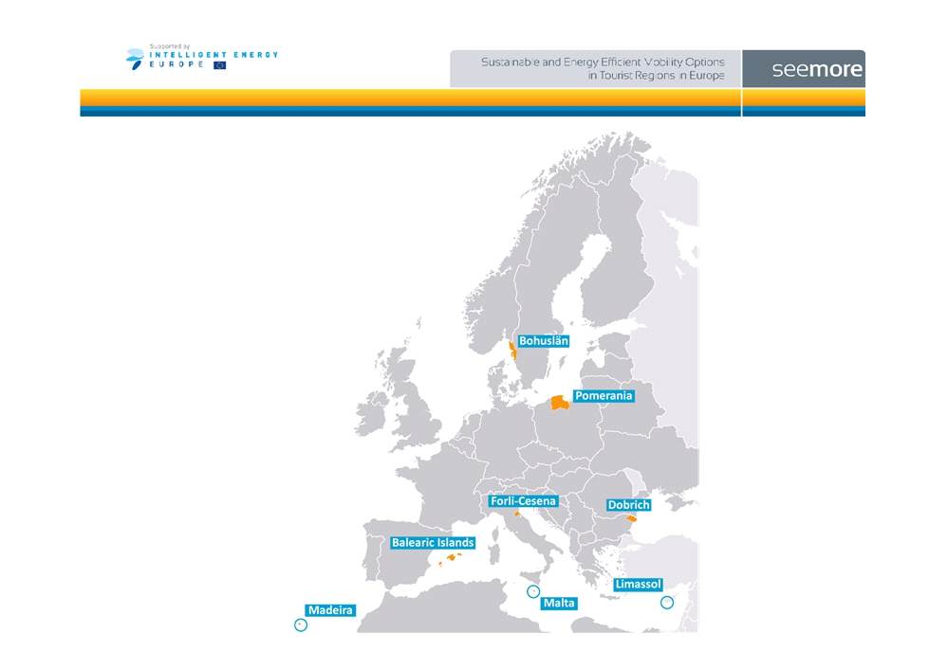
Implementation regions
3

Slide 4
Background
• Leisure transport accounts for 50% of all travel in industrialized countries and is expected to rise
• Tourist regions are vulnerable, because:
Even larger share of leisure related trips
Season peaks lead to capacity problems and congestion
Trend of more individualized holidays favors private car use
Balance between accessibility and attractive natural environment
• SEEMORE offers (information on) alternatives to the car
4

Slide 5
Objectives and main steps
• Objectives:
Increased tourists´ awareness about sustainable mobility
Co-operation between the tourism and mobility sectors
A shift of tourists towards more sustainable modes
Share knowledge with other European regions
• Main Steps:
Overview of good practices and set up the co-operation framework in the regions
Implementation of actions in 8 regions
Evaluation and transfer of experience to other regions
5

Slide 6
Expected Impacts
Increased co-operation between tourism and mobility sectors
Change in travel behavior of targeted visitors:
5-15% reduction of car use for leisure trips
5% increase in non-motorized leisure trips
Increase in public transport use
Inspire other regions to implement similar actions
Reduction of annual primary energy use with 796 toe/year and of greenhouse gas emissions with 2.170t CO2 e/year
6

Slide 7
Partners
CINESI Transport Consultants Spain
Mallorca Transports Consortium Spain
Trivector Traffic AB Sweden
Association of Local Authorities Fyrbodal Sweden
FGM-AMOR Austrian Mobility Research Austria
Common Europe Pomeranian Association Poland
Municipality of Choczewo Poland
Club Sustainable Development of Civil Society Bulgaria
Province of Forlì-Cesena Italy
Central European Initiative Italy
Limassol Tourism Development and Promotion Co Ltd Cyprus
Stratagem Energy Ltd Cyprus
Horários do Funchal Public Transport Portugal
Local Councils’ Association Malta

Slide 8
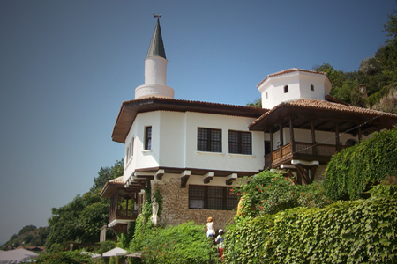
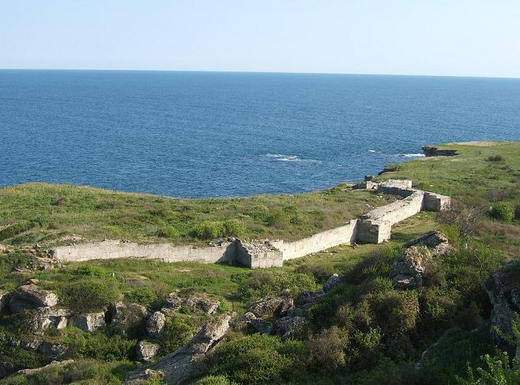
SELECTED BULGARIAN REGION - DOBRICH
Dobrich region, Bulgaria

Slide 9
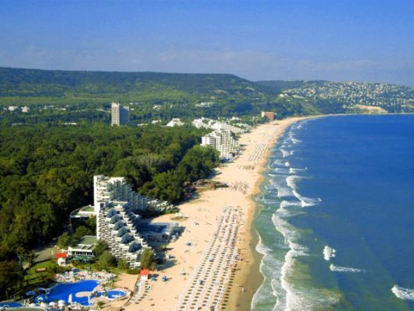
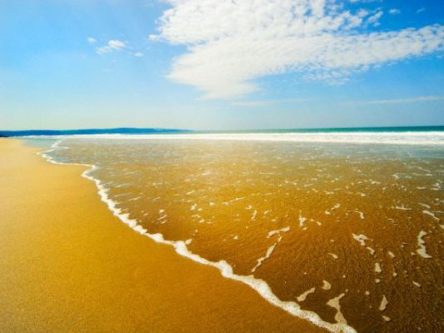
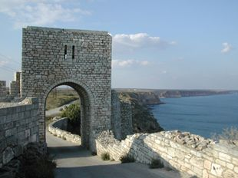
General description of the tourist region
Main attractions: spacious beaches of fine golden sand, shallow sea along the beaches, curative power of mineral waters and mud baths, picturesque protected areas and natural preserved zones with rare births and vegetation, anthropogenic resources from different historic eras, rural tourism in small villages, facilities for water sports and golf, many luxury hotels, restaurants and night clubs.
Dobrich region, Bulgaria
9
Notes:
9

Slide 10
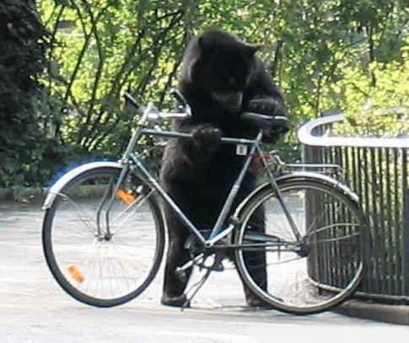
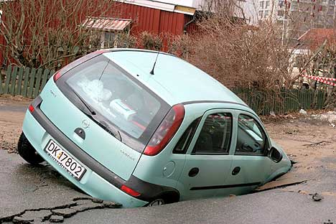
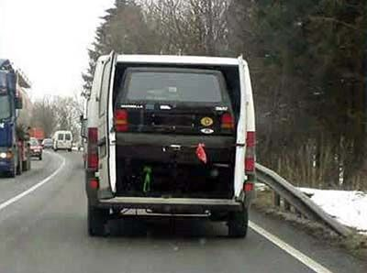
Relevant results and findings from the regional survey
Modal split among the target group
The average number of day trips per year in the target area is 1400. Percentage of day trips made from tourists in targeted area by different modes of transport is:
- Walking – 11 %;
- Cycling – 3.5 %;
- public transport – 29 %;
- car – 56.5 %;
- ship/ferry – 0;
- others – 0;
Dobrich region, Bulgaria
10
Notes:
10

Slide 11
Relevant results and findings : Needs and preferences of tourists
To have more well maintained (and enlightened by night) pedestrian alleys
To have better constructed and maintained bicycle paths
To have more possibilities for bike rental at reasonable prices
To organize electrical vehicle transport (small trains) for transportation inside Albena resort and water transport (boats) among the resorts
To have more parking places around the main attractions (Balchik palace, Kaliakra Cap)
To have more information about the resort areas (maps with most interesting sites) and indication how to reach them by different mode of transportation
To have more information about the time tables of the PT
Foreign tourists would like to have this information at least in English and, if possible, in other languages (Russian, Romanian).
Dobrich region, Bulgaria
11
Notes:
11

Slide 12
Local strategy developed by the project team and discussed and approved by local decision makers
The stakeholders fully agreed with the proposed local vision:
“MORE ATTRACTIVE AND ENVIRONMENTAL FRIENDLY SEASIDE DOBRUDZA THROUGH SUSTAINABLE TOURISM AND TRANSPORT”
The main goals were defined as follows:
To develop a strong information and promotion campaign thus introducing the term “Mobility Management’ in the region and explaining the benefits of sustainable tourism and transport development.
To introduce new mobility measures in resort areas thus linking tourism and transport sectors
To increase the energy effectiveness of the transport
Dobrich region, Bulgaria
12
Notes:
12

Slide 13
Main conclusions (6)
DOBRICH STRATEGY AND ACTION PLAN (FINAL – 04.11.2012)
Axis 1 – Information and marketing actions concerning sustainable mobility
This axis contained many measures, aiming to improve the quality and accessibility to information about mobility management (MM) in general and the possible mobility options in tourism sector. An important step to reach this goal is the increased co-operation between local authorities, transport and tourism companies in providing mobility information. This axis includes 6 measures.
Axis 2 – Introduction of new mobility options
Here it is important to introduce in real practice some convenient mobility options in order to make the transport in tourism areas more sustainable through 3 measures.
Axis 3 – Achieving energy saving in tourism sector through mobility measures
This axis aims to achieve energy saving in tourism sector by using more PT, bicycles and walking by foot and by introducing the use of electric vehicles where possible. It has 3 measures.
Dobrich region, Bulgaria
13
Notes:
13

Slide 14
Task | Responsible actor | Participants | Timing
Measure 1.1.: Definition and elaboration of the integrated sustainable mobility information package for visitors (public transport, urban mobility, parking, pedestrian areas and routes, guided tours, etc.), with description of the leisure activities and how to reach them. Elaborated in Bulgarian, Russian, English and German. Distribution of up to 2.500 copies | Project team and subcontractor | Tourism and transport operators, municipalities and Albena resort mana-gement | June 2013
Measure 1.2. Regional visitors’ sustainable mobility guide including complete and integrated information on mobility and integration of mobility information in hotels’ package to customers and in hotel services. 50 hotels to be involved. | Project team and subcontractor | Tourism and transport operators, municipalities and Albena resort mana-gement | May 2014
Measure 1.3. Training on integrated sustainable mobility options for 80 professionals in direct contact with visitors (hotels, bus drivers, and leisure activities staff). | Project team and subcontractor | Municipalities, district administration | Dec.2014
Measure 1.4. Organizing a photo-competition and exhibition in Albena for promoting the sustainable mobility measures, in summer 2014. | Project team and subcontractor | Tourism and transport operators, municipalities and Albena resort mana-gement | June 2014

Slide 15
Measure 1.5. Organizing 2 series of emission of video-spot for the region promoting local attractions and the sustainable access to them.- summer 2013-2014. | Project team and subcontractor | Regional TV-operators | June 2013 – September 2014
Measure 1.6. Direct advertising – dissemination of advertising materials (posters, teaser-postcards, T-shirts, caps) among the target groups – tourists, hotel and restaurant staff, local youth, etc. | Project team and subcontractor | Tourism and transport operators, municipalities and Albena resort mana-gement | March 2013 – March 2015
Task | Responsible actor | Participants | Timing
Measure 2.1.Increased public transport selling points: hotels, regional transport terminals, travel agencies. At least four new points. | Dobrich transport operator, municipalities | Albena resort management | May 2014
Measure 2.2. Integrated packages (sustainable mobility + leisure activities) with the goal of selling at least 1.000 integrated packages during the last project summer. | Project team and subcontractor | Albena resort management; Tourism and transport operators, municipalities | Dec.2013
Measure 2.3. Parking policies to disincentives car use to access leisure destinations and urban areas with visitors concentration. 5 meetings with local authorities to discuss the parking policies, leading to a decrease of 200 free parking spaces in town centres or leisure attractions | Project team and municipalities | Albena resort management; Tourism and transport operators | May 2014

Slide 16
Task | Responsible actor | Participants | Timing
Measure 3.1. Improving PT-services for visitors and local people in rural areas; PT services at leisure/tourist destinations; sustainable mobility options to major events. | Transport operators | Municipalities; project team | Dec.2014
Measure 3.2. Bicycle mobility transport and services: Introducing a bicycle sharing/rental schemes for visitors; Complementary infrastructure and services to support cycling: 5 kilometres of new segregated bicycle lanes and 100 new public parking places for bicycles | Municipalities | Project team; Albena resort management; private companies | Dec.2014
Measure 3.3. Training of up to 40 local planners on how to consider visitors when planning mobility measures and how to consider mobility when planning tourist infrastructure resulting into SUMP for Kavarna | Project team | Albena resort management; Tourism and transport operators, municipalities | Dec.2014

Slide 17
WHAT IS ACTUALLY IMPLEMENTED
Axis 1 – Information and marketing actions concerning sustainable mobility:
MOBILITY PACKAGES (CONTAINING A BROCHURE WITH LOCAL PT TIME SCHEDULES AND COACH EXCURSIONS AND LEAFLET WITH LOCAL SITES TO BE VISITED AND HOW TO REACH THEM IN A SUSTAINABLE WAY) ELABORATED, PRINTED AND DISSEMINATED;
FIRST WORKSHOP FOR TOURISM STAKEHOLDERS CONDUCTED IN BALCHIK IN MARCH. MAIN TOPIC: “SUSTAINABLE MOBILITY – INTRODUCTION AND EUROPEAN BEST PRACTICES);
SECOND WORKSHOP PREPAIRED AND WILL BE HELD ON 28.06.2013 IN DOBRICH IN THE FRAMES OF THE EU ENERGY WEEK (LISTED AS AN EU EVENT)
T-SHIRTS AND CAPS PRODUCES AND WILL BE DISSEMINATED DURING THE EVENT ON 28.06.2013, WHERE THE YOUTH WILL PARTICIPATE IN OPEN-AIR MOBILITY EVENTS (VELO-COMPETITION, ETC.)
POSTERS AND TEASER POSTCARDS PREPARED AND WILL BE PRINTED AND DISSEMINATED IN BULGARIAN AND ENGLISH.

Slide 18
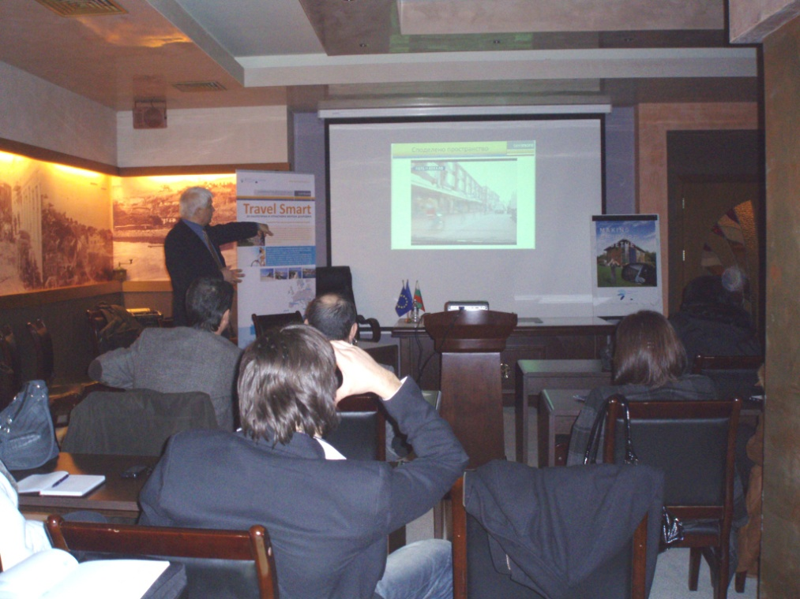
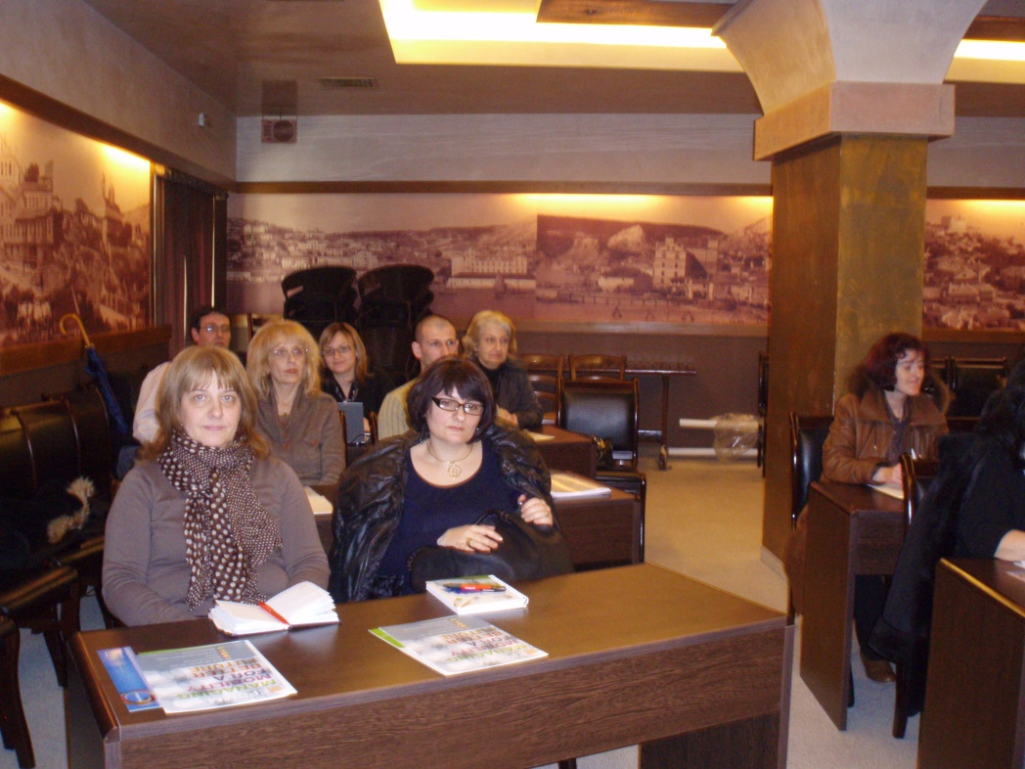

Slide 19
Thank you for your attention!
Prof. Lucia Ilieva
+359 2 8513558
mail@csdcs.org
www.csdcs.org
19
Notes:
19

